Slide 1

Tools for Visualizing Networks

Slide 2
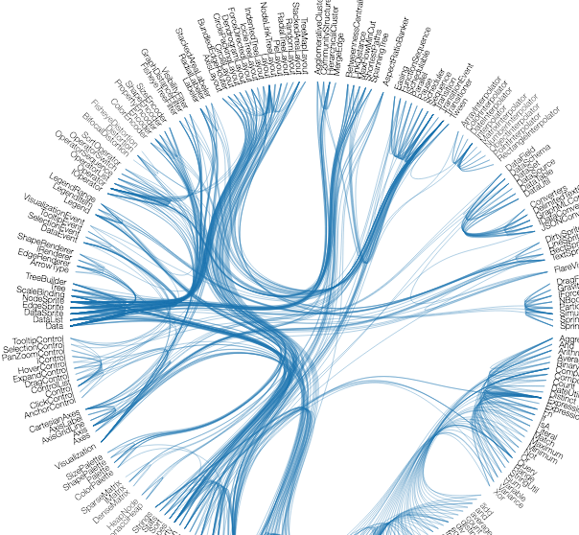
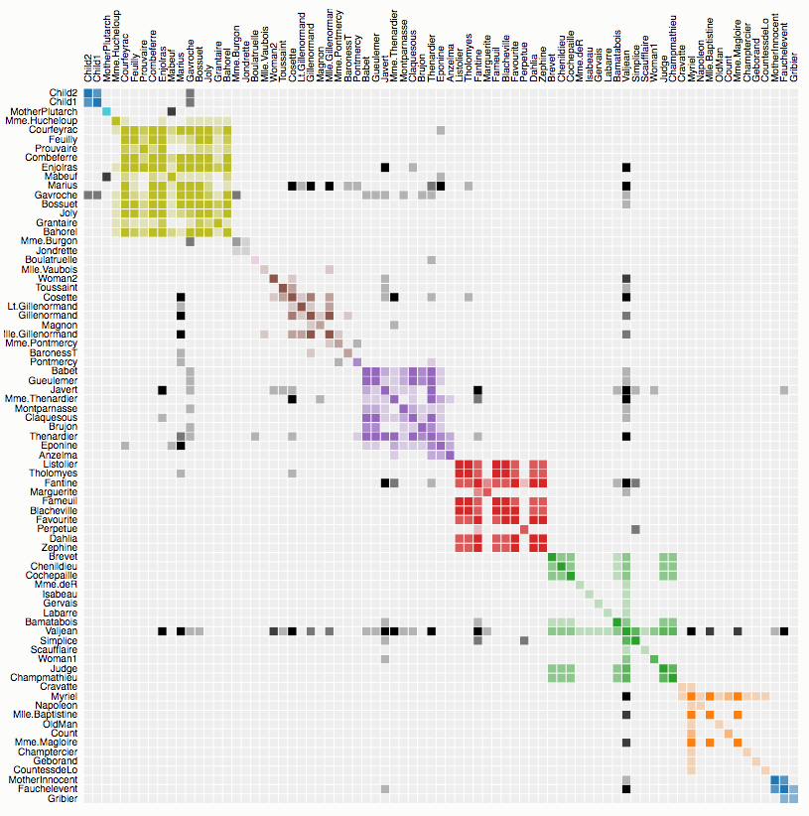
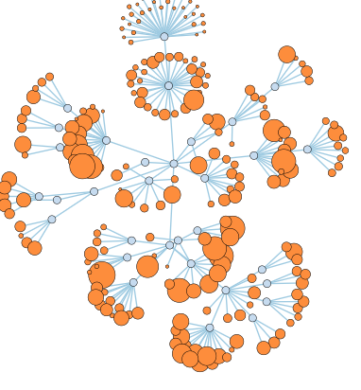
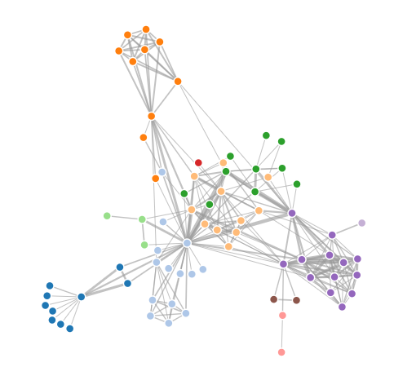
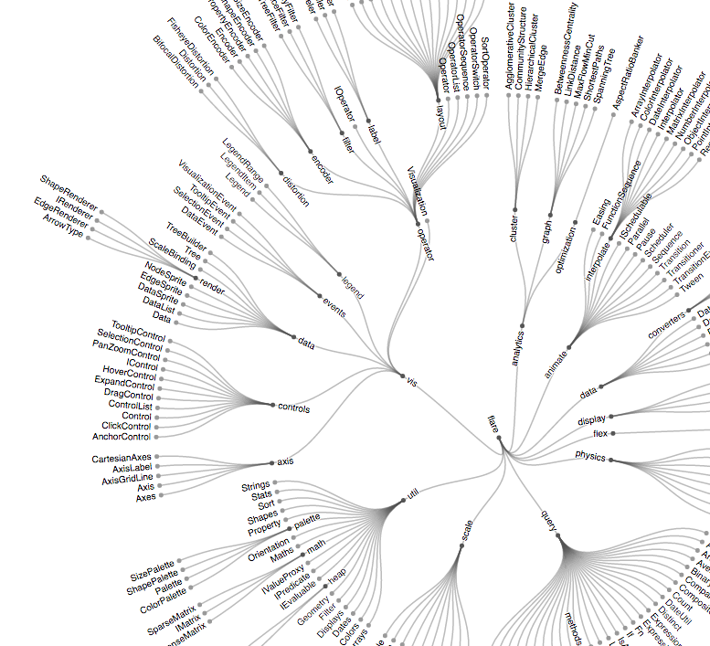
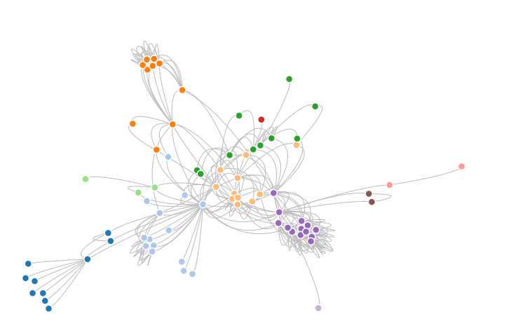
D3.js
Many options:
Notes:
Flexible layout options
Build your own if you want!

Slide 3
Graphviz
Notes:
and for that matter, tikz
building basic stuff!

Slide 4
Circos
Notes:
http://circos.ca/intro/published_images/img/circos-gloeobacter.png
http://circos.ca/intro/published_images/img/circos-placenta.png

Slide 5
Gephi
“Tableau for networks”
Many popular layout algorithms
Works with tabular network data
Open-source, lots of statistics, somewhat prone to crash computer

Slide 6
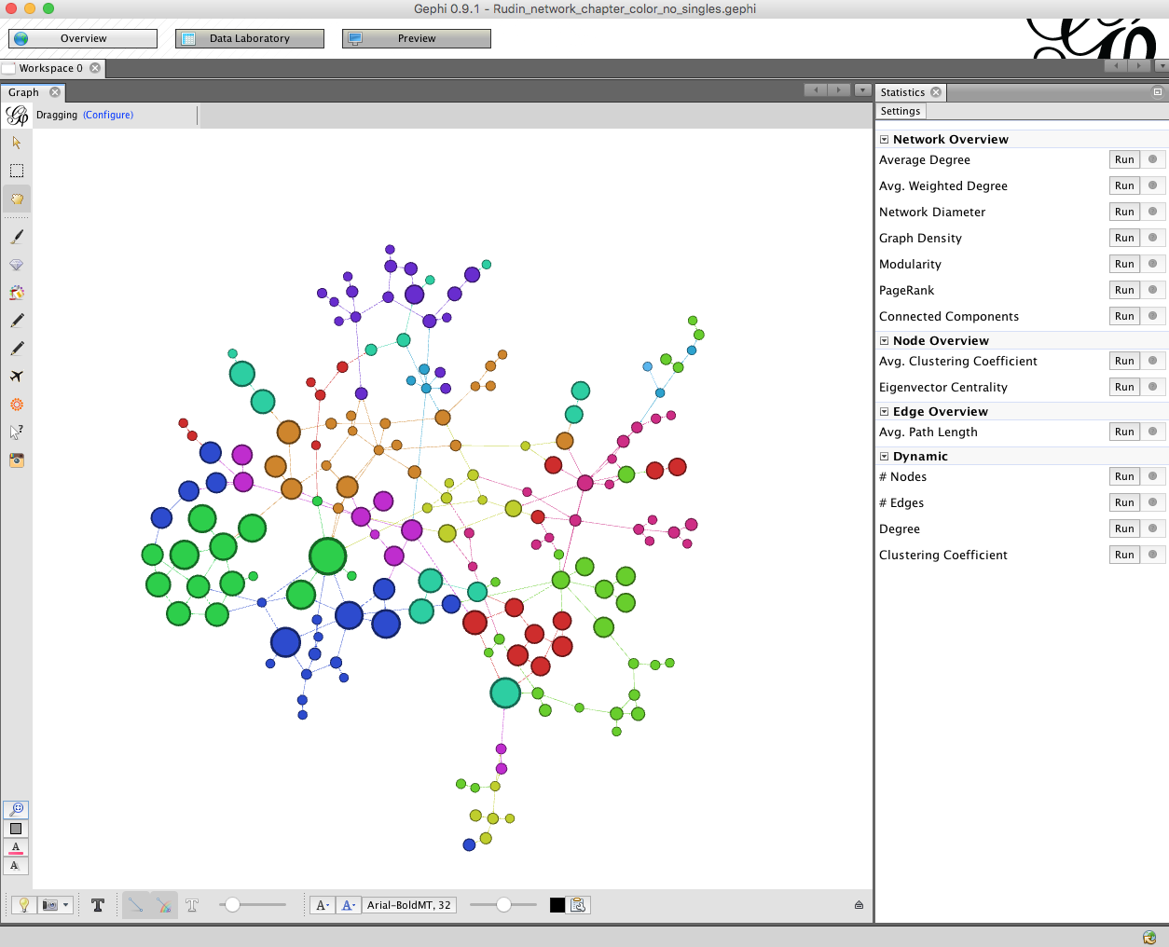

Slide 7
sigma.js, Raphael, Cytoscape
?
Notes:
I don’t recommend any of these, given the other options.

Slide 8
Maryland HCI Lab
ManyNets:
NodeXL:
+more!

Slide 9
neo4j
Notes:
yes, it’s a graph data base

Slide 10
https://nicolewhite.github.io/2014/06/30/create-shiny-app-neo4j-graphene.html

Slide 11
NetworkX
Notes:
we’ll see this in action next!

Slide 12


